Slide 1
NIOSH Informational Video Series
NIOSH partnered with Department of Homeland Security’s Science and Technology Directorate as well as other federal agencies and the ambulance industry to develop a 7-part video series that covers new crash test methods.
Video series became available on the NIOSH EMS Workers webpage the week of May 22, 2017
www.cdc.gov/niosh/topics/ems/videos.htm

Slide 2
Video Series Goals & Distribution
Desire is to push information out to EMS workers and ambulance purchasers nationwide.
Tried to make the video informative without a lot of technical detail.
Over 30 participants on camera.
Video series available on NIOSH website and hopefully linked by others including NASEMSO.
DVDs will be mailed soon to all State EMS Directors, State Medical Directors, and ambulance manufacturers. These could also be reproduced by states or others for training on distribution.
Hopefully, state offices will push the link out broadly within their respective EMS communities.
We also expect builders to use some of this information to encourage buyers to seek safer solutions

Slide 3
Video 1: History, Injuries & Standards
NFPA 1917
Standard for
Automotive
Ambulances
Effective 2016
2nd Edition

Slide 4
Video 2: Crash Testing an Ambulance
This video highlights the value of crash testing to the development of all our subsequent test methods.
The energy measured in these crash tests is used as the input to all of our other testing.

Slide 5
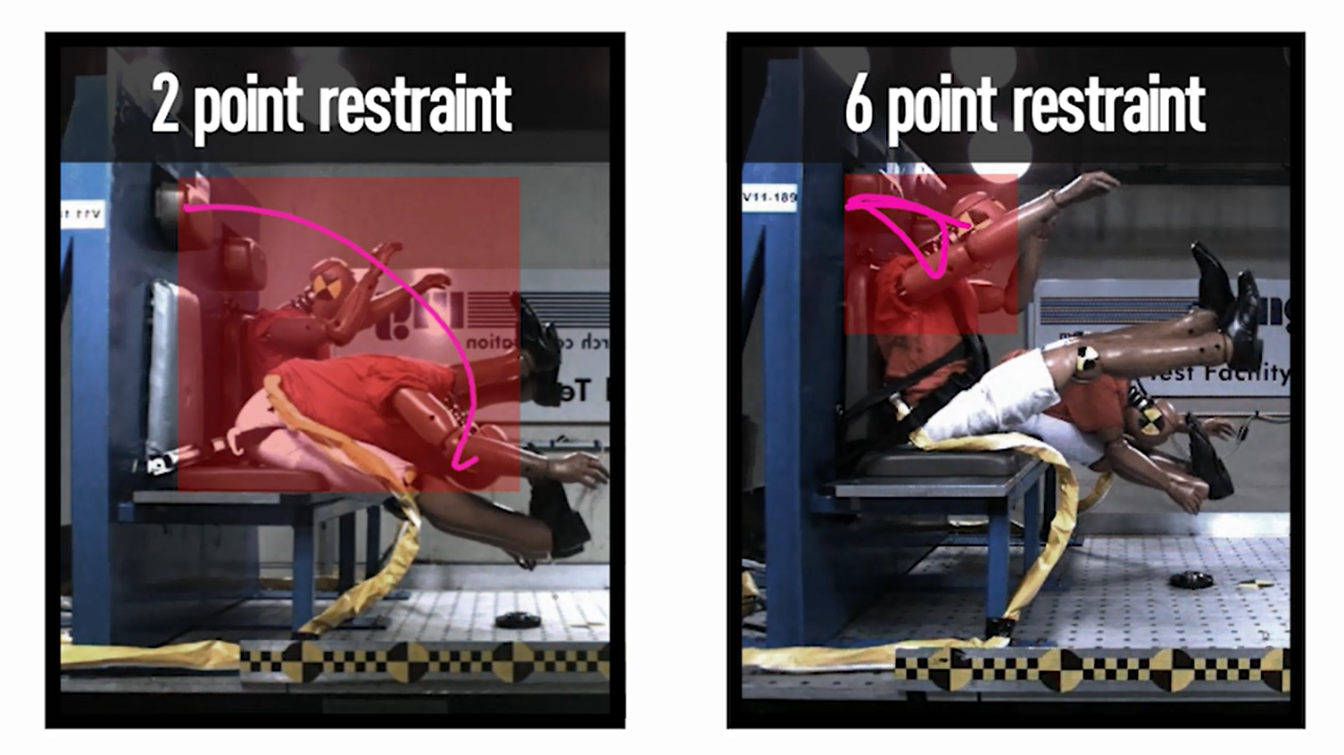
Video 3: Patient Compartment Seat Testing
This video covers the new seat testing requirements including the measurement of head travel during a crash.
At the end of this video we also provide some seating demos from research partners EVS and Wise.

Slide 6
Video 4: Patient Cot & Restraint Testing
This video covers the new cot testing requirements including the change in patient excursion derived from the change in restraint location.
At the end of this video we also provide demos of manual and powered cots from research partners Ferno and Stryker.

Slide 7
Video 5: Equipment Mounts & Cabinets
This video highlights the risks of flying equipment and supplies as described by several providers and manufacturers.
Our goal is to encourage EMS workers to get away from the habit of placing loose equipment on the action area or bench seat.

Slide 8
Video 6: Body and Floor Strength
This video covers testing requirements designed to improve roof and floor strength.
Partners explain the value of the new tests to worker and patient safety.
Industry leading rollover strength testing!!

Slide 9
Video 7: Human Factors Design Guidebook
This video hopes to pull everything together for providers and ambulance builders.
The goal is to help buyers know they can influence the design of their ambulance based on their unique needs.

Slide 10
NIOSH Infographic
Provides a quick overview of all SAE Test Methods
Highlights the breadth of this effort based on number of tests completed
Great hook to help lead EMS providers to the video series
https://www.cdc.gov/niosh/topics/ems/pdfs/Ambulance-INFOGRAPHIC-051617.pdf

Slide 11
Contact Information
Jim Green 304-285-5857 JGreen@cdc.gov
“The findings and conclusions in this presentation are those of the author and do not necessarily represent the views of the National Institute for Occupational Safety and Health (NIOSH). Mention of company names or products does not imply endorsement by NIOSH.”
Notes:
11

